Slide 1
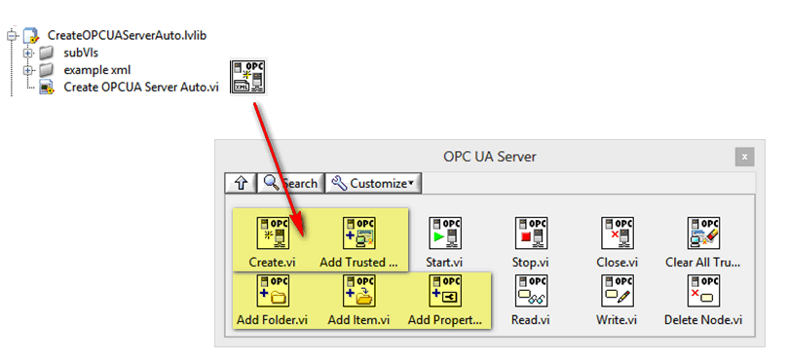

Slide 2
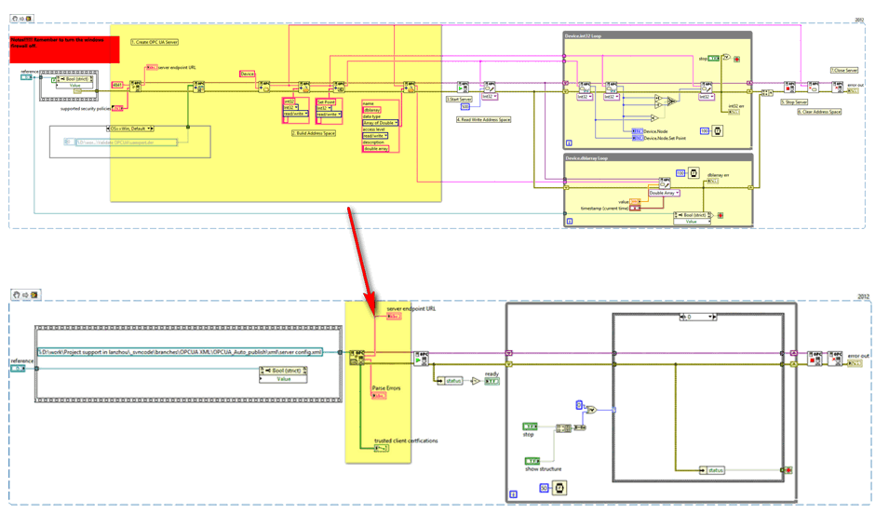

Slide 3


Configure Server
Server Name*
Publish Server structure
Folders
Initialization
Start Server
Running…
Items
Properties
Port
Trusted Clients
Publish the initial value of data points
Certification
Before
After
Load Configuration File
Server Name
Start Server
Running…
Port
Trusted Clients
Create Server Automatically
Configure Server
Publish Server structure
Initialization
Server Structure
Initial Value
Certification

Slide 5
